Slide 1
微机原理与接口技术
Theory and Interface Technology of Microcomputer
北京化工大学
信息科学与技术学院
主讲教师： 郭青
guoqing@mail.buct.edu.cn

Slide 2
1.3
THE MICROPROCESSOR
AND ITS ARCHITECTURE

Slide 3
1.3.1 Introduction
Programmable device
Internal Microprocessor Architecture
The programming model of the Intel 8086 through the Pentium 4
8086/8088 hardware specification
Key point
Describe function and purpose of programmable register
Detail the flag register and purpose of each flag bit

Slide 4
Function of Microprocessor
The microprocessor, sometimes referred to as the CPU (central processing unit), is the controlling element in a computer system.
Control memory and I/O through Buses.
Three main tasks
Data transfer between itself and the memory or I/O systems.
Simply arithmetic and logic operations.
Program flow via simple decisions.

Slide 5
1.3.2
INTERNAL MICROCOMPUTER ARCHITECTURE

Slide 6
1. The Programming Model
Program visible
Its registers are used during application programming and are specified by the instructions
Program invisible registers 80286 and above
notes
8086, 8088 and 80286 — 16-bits
80386 through Pentium 4 — 16-bits and full 32-bits

Slide 7
1. The Programming Model
8-bits names
32-bits names
16-bits names
CS
DS
ES
SS
FS
GS
Code
Data
Extra
Stack
EAX
EBX
ECX
EDX
ESP
EBP
EDI
ESI
 | AH A | X AL
 | BH B | X BL
 | CH C | X CL
 | DH D | X DL
 | SP
 | BP
 | DI
 | SI
Accumulator
Base Index
Count
Data
Stack pointer
Base pointer
Destination index
Source index
Exist on 80386 and above
EIP
EFLAGS
 | IP
 | FLAGS

Slide 8
2. General-purpose Registers
Or multipurpose registers 通用寄存器
EAX (32-bits) AX(16-bits) AH, AL (8-bits) accumulator
EBX BX BH, BL base index
ECX CX CH,CL counter
EDX DX DH, DL data
EBP BP base pointer
EDI DI destination index
ESI SI source index
EAX 累加器 EBX基址寄存器
ECX计数器 EDX数据寄存器
EBP基址指针
ESI源变址寄存器 EDI目标变址寄存器

Slide 9
3. Special-purpose Register
EIP (Instruction pointer) 指令指针寄存器
Address the next instruction in a section of memory defined as a code segment.
Real mode — IP (16-bits)
Protected mode — EIP (32-bits) 80386 and above
ESP (stack pointer) 堆栈指针寄存器
Address an area of memory called stack.
SP (16-bits)
ESP (32-bits) 80386 and above

Slide 10
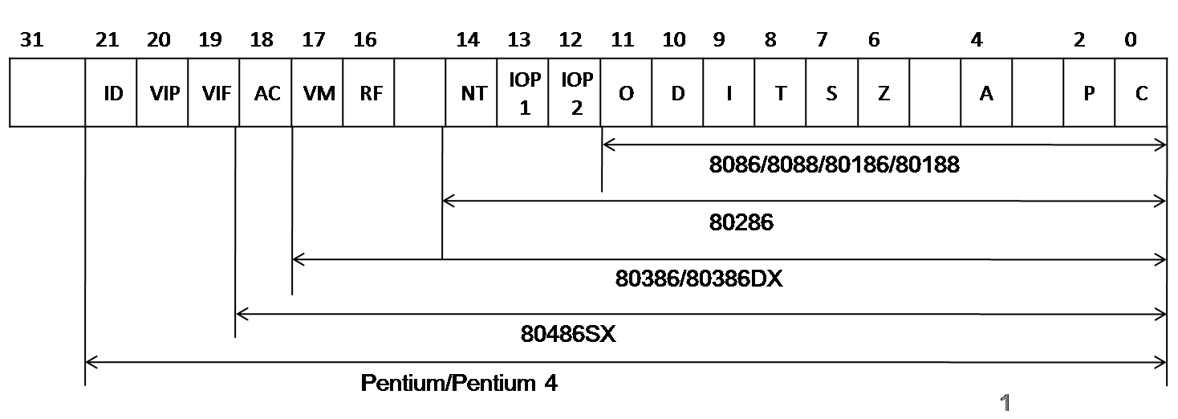
3. Special-purpose Register
EFLAG 标志寄存器
Indicate the condition of microprocessor
Control its operation
FLAG(16-bits) 8086 — 80286
EFLAG (32-bits) 80386 and above

Slide 11
EFLAGS
Flags in 8086
CF (carry) 进位标志
Holds the carry after addition or the borrow after subtraction.
PF (parity) 奇偶标志
Logic 0 for odd parity, and logic 1 for even parity.
AF (auxiliary carry) 辅助进位标志
Holds the carry (half-carry) after addition or the borrow after subtraction between bits positions 3 and 4 of the result.

Slide 12
EFLAGS
ZF (zero) 零标志
Shows that the result of an arithmetic or logic operation is zero.
ZF=1, result is zero. ZF=0, result is not zero.
SF (sign) 符号标志
Holds the arithmetic sign of the result after an arithmetic or logic instruction executes.
SF=1, sign bit is set or negative.
SF=0, sign bit is clear or positive.

Slide 13
EFLAGS
OF (overflow) 溢出标志
Overflow occurs when signed numbers are added or subtracted. An overflow indicates that the result has exceeded the capacity of the machine.
CF, PF, AF, ZF, SF, OF 状态标志
These six flags indicate condition of the microprocessor, and change after most arithmetic and logic operations.

Slide 14
EFLAGS
TF, IF and DF control the operation of microprocessor
TF (trap) 单步操作标志，或陷阱标志
Enables trapping through debugging feature.
TF=1, program is debugged to find an error or bug.
TF=0, debugging feature is disabled.
IF (interrupt) 中断标志
Controls operations of the INTR (interrupt request) input pin.
IF=1, INTR pin is enabled.
IF=0, INTR pin is disabled.

Slide 15
EFLAGS
TF, IF and DF control the operation of microprocessor
DF (direction) 方向标志
Selects either the increment or decrement mode for the DI and/or SI registers during string instructions.
DF=1, decrement.
TF=0, increment.

Slide 16
4. Segment Registers
段寄存器 generate memory addresses when combined with other registers
CS (code)
The code segment is a section of memory that holds the code —— programs and procedures
DS (data)
The data segment is a section of memory that contains most data.
ES (extra) 附加段
The extra segment is an additional data segment that is used by some of the string instructions to hold destination data.

Slide 17
Segment Registers
SS (stack) 堆栈
The stack segment defines the area of memory used for the stack.
The stack entry point is determined by the SS and SP.
FS and GS available in 80386 and above
two supplemental memory segment.

Slide 18
1.3.2
8086/8088 PIN-OUTS AND THE PIN FUNCTIONS

Slide 19
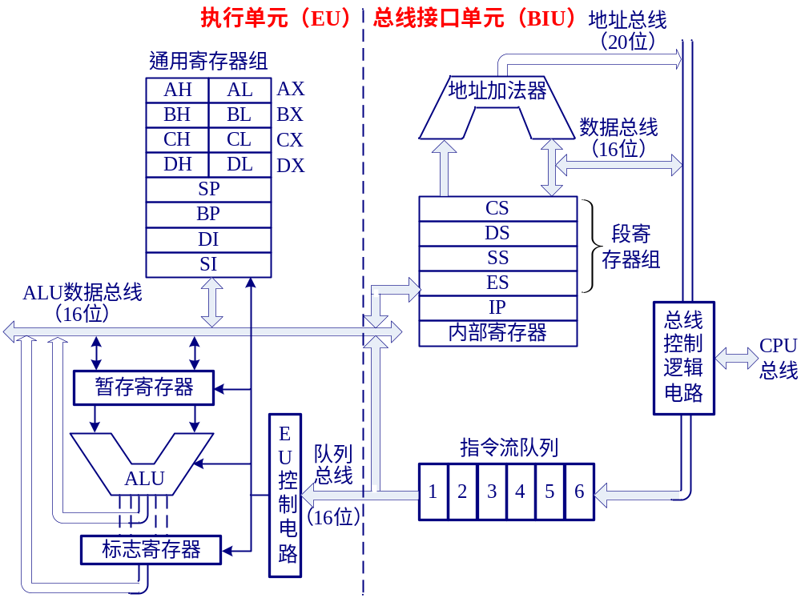
1. 8086/8088CPU的内部结构框图
Bus Interface Unit
Execute Unit

Slide 20
Pin-out
GND
AD₁₄
AD₁₃
AD₁₂
AD₁₁
AD₁₀
AD₉
AD₈
AD₇
AD₆
AD₅
AD₄
AD₃
AD₂
AD₁
AD₀
NMI
INTR
CLK
GND
1 40
2 39
3 38
4 37
36
35
34
33
32
31
30
29
28
27
26
25
24
23
22
21
VCC(+5V)
AD₁₅
A₁₆/S₃
A₁₇/S₄
A₁₈/S₅
A₁₉/S₆
BHE/S₇
MN/MX
RD
HOLD(RQ/GT₀)
HLDA(RQ/GT₁)
WR(LOCK)
M/IO(S₂)
DT/R(S₁)
DEN(S₀)
ALE(QS₀)
INTA(QS₁)
TEST
READY
RESET
GND
AD₁₄
AD₁₃
AD₁₂
AD₁₁
AD₁₀
AD₉
AD₈
AD₇
AD₆
AD₅
AD₄
AD₃
AD₂
AD₁
AD₀
NMI
INTR
CLK
GND
1 40
2 39
3 38
4 37
36
35
34
33
32
31
30
29
28
27
26
25
24
23
22
21
VCC(+5V)
AD₁₅
A₁₆/S₃
A₁₇/S₄
A₁₈/S₅
A₁₉/S₆
SS₀/(HICH)
MN/MX
RD
HOLD(RQ/GT₀)
HLDA(RQ/GT₁)
WR(LOCK)
M/IO(S₂)
DT/R(S₁)
DEN(S₀)
ALE(QS₀)
INTA(QS₁)
TEST
READY
RESET
8086引脚
8088引脚

Slide 21
2. Pin Connections
8086 20 address bus lines
16 data bus lines
AD15—AD0 address/data bus 双向三态，分时复用
active ALE=1: address bits A15—A0
active ALE=0: data
hold acknowledge: high-impendence
A19/S6—A16/S3 address/status bus 输出，三态
S6 remains 0 S5 indicates condition of IF
S4 and S3 show which segment is accessed
0 0 extra segment
0 1 stack segment
1 0 code or no segment
1 1 data segment

Slide 22

2. Pin Connections
Control pins
输出，低电平有效 Whenever the read signal is a logic 0, the data bus is receptive to data from the memory of I/O device
READY
输入，高电平有效 This input is controlled to insert wait states in the timing of the microprocessor.
If READY=0, the microprocessor enters into wait stats.
If it is placed at a logic 1 level, it has no effect on the operation of microprocessor.
INTR
输入，高电平有效。Interrupt request is used to request a hardware interrupt.
If INTR hold high when IF=1, the 8086 enters an interrupt acknowledge cycle

Slide 23

2. Pin Connections
输入，低电平有效。The TEST pin is an input that is tested by the WAIT instruction.
If it is a logic 0, the WAIT instruction functions as a NOP.
If it is a logic 1, the WAIT instruction waits for it to become 0
NMI
输入，上升沿触发。 The non-maskable interrupt 非屏蔽中断
Similar to INTR except that the NMI interrupt does not check to see whether the IF flag is a logic 1.
RESET
输入，高电平有效。
The RESET input causes the microprocessor to reset itself if this pin is held high for a minimum of four clocking periods

Slide 24


Pin Connections
输入信号端。
The minimum/maximum mode pin selects either minimum mode or maximum mode operation
高8位数据总线允许/状态线 输出，三态
The bus high enable pin is used to enable the most-significant data bus bits (D15 —D8) during a read or a write operation.
The state of S7 is always a logic 1

Slide 25
Pin Connections
Clocking and power pins
CLK The clock pin provides the basic timing signal.
系统时钟输入信号
The clock signal must have a duty cycle of 33%
(high for one-third of the clocking period and low for two-thirds)
V_{CC} The power supply input provides a +5.0V, ±10% signal to the microprocessor.
GND The ground connection

Slide 26
3. Minimum Mode Pins
8284
CLK
+5V
MN/MX
地址
锁存器
ALE
地址总线
数据
收发器
DEN
数据总线
DT/R
RD
…
控制总线
最小模式基本配置

Slide 27



3. Minimum Mode Pins
is connected directly to +5.0 V —— minimum mode
输出。selects memory or I/O.
This pin indicates that the microprocessor address bus contains either a memory address or an I/O port address.
输出，Write line is a strobe (写选通)
Indicates that the 8086 is outputting data to a memory of I/O device.
The data bus contains valid data for memory or I/O.

Slide 28




Minimum Mode Pins
Interrupt acknowledge signal is a response to the INTR pin. 中断响应信号，输出
ALE Address latch enable show that the 8086 address/data bus contains address information. 地址锁存允许信号，输出
Data transmit/receive signal shows that the data bus is transmitting
or receiving 输出
DEN data bus enable actives external data bus buffer
输出

Slide 29

Minimum Mode Pins
Hold 总线保持请求信号，输入
The hold input requests a direct memory access (DMA)
1: requests DMA 0: executes software normally
HLDA 总线保持响应信号，输出
Hold acknowledge indicates that the 8086 has entered the hold state.
This status line is equivalent to the S0 pin in maximum mode.
This signal is combined with IO/M and DT/R to decode the function of current bus cycle.

Slide 30
4. Maximum Mode Pins
8284
to ground
CLK
最大模式配置
MN/MX
ground
地址
锁存器
地址总线
数据
收发器
DEN
数据总线
DT/R
RD
…
总线
控制器
控制总线

Slide 31



4. Maximum Mode Pins
The status bits indicate the function of the current bus cycle
总线请求信号(输入)/总线请求允许信号(输出)
The request/grant pins request direct memory accesses (DMA) during maximum mode operation. Bi-directional
总线封锁信号(输出)
Lock peripherals off the system.
QS1 and QS0 指令队列状态信号(输出)
The queue status bits show the status of the internal instruction queue.

Slide 32
Summary
Internal Microprocessor Architecture
The programming model of the Intel 8086 through the Pentium 4
General-purpose and special-purpose registers
FLAGS
8086/8088 hardware specification
Pin out, minimum mode and maximum mode

